Slide 1
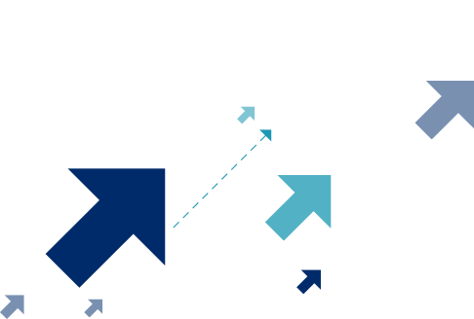
TIME TO INVEST
Cabinet of Ministers of Ukraine
12/2 Hrushevskoho St., Office 148
Kyiv, Ukraine, 01008

Slide 2
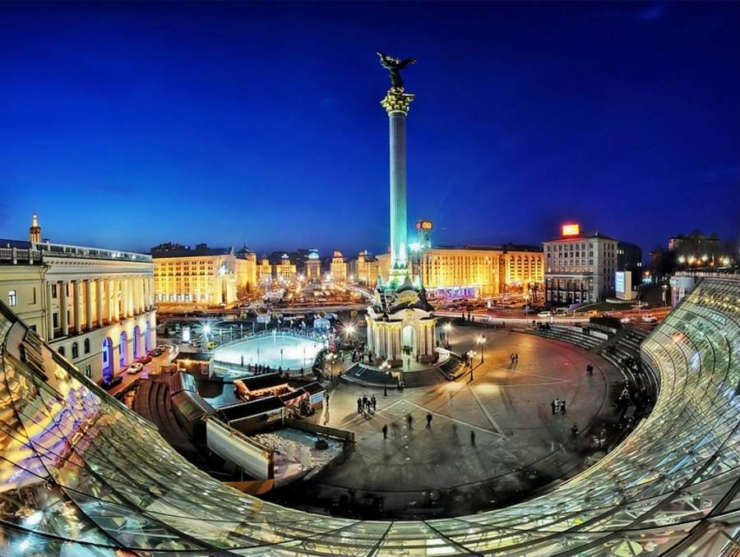
Ukraine – The Basics
Capital
Area
Population
Government
Currency
GDP (PPP)
Economy
Foreign
relations
Kyiv
603,628 km²
44.6 million
Unitary, Parliamentary - Presidential
Ukrainian hryvnia (UAH)
$340 billion
Market
Strategic goals:
European and Euro-Atlantic integration

Slide 3
Ukraine – The Basics
Major industries: energy, metallurgy, chemical, manufacturing, massive high-tech industrial base, world player in agriculture industry, fast developing IT sector
Member, UN, OSCE, IMF, WB, EBRD, the Council of Europe, EU Energy Community, GUAM.
16 free trade agreements with 45 countries, most recently with the EU (DCFTA) and Canada (CUFTA).
Capital: Kyiv; pop. of 2.9 mln,
7th most populous city in Europe
46th largest country in the world
32nd most populous country
in the world

Slide 4
Rebounding Economic Indicators

Slide 5
Inflation falling; FX Reserves increased; Balances improving

Slide 6
Since 2015, production & consumption have returned to positive territory

Slide 7
2014: The Big Transformation Begins
“
Solidified Ukraine’s determination to be European
Affirmed Ukraine’s desire to live in a free, democratic, western-oriented and economically stable country
A new, young generation of technocratic, pro-business, English-speaking reformers in government
More has been accomplished in last 3 years than in preceding 23 years since independence.
Ukraine is carrying out intense and unprecedented reforms across its economy and political system, while its democratic institutions have been further revitalized.
Vision + Reforms + Economic Stabilization = Time to Do Business

Slide 8
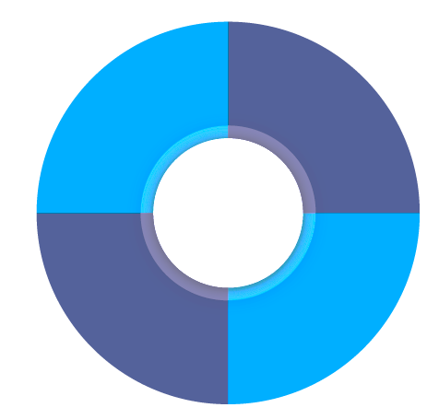
Leading Sectors of Development
Agribusiness
Energy
8th in the world with the most arable land
By mid-2020s, Ukraine is predicted to be No. 3, in food production worldwide
Estimated total investment in alternative energy shall reach $18bn by 2020
4th largest European natural gas resource base with significant scope for growth
Hi-Tech,
R&D, IT
Manufacturing
Infrastructure
Leading aerospace
Auto industry parts
Certified pharmaceuticals
22 000 km of railways, 170 000 km of roads, 13 sea and 16 river ports, 19 airports
Aging infrastructure poses huge investment needs

Slide 9
Competitive Advantages
5 Pan-European transport corridors
18 EU routes
Ideal trade hub between EU, Middle East and Asia
Located on the Black Sea; many ports
26.4 UAH to 1 USD (5/2017)
Highly competitive labor, manufacturing and production costs
Cost
Efficient
Location
Ukraine’s
Competitive
Strengths
Agricultural Land
Forestry
Sea and riverports
Extensive rail and road networks
99.7% literacy rate
Creative, resourceful, determined
People
Resources

Slide 10
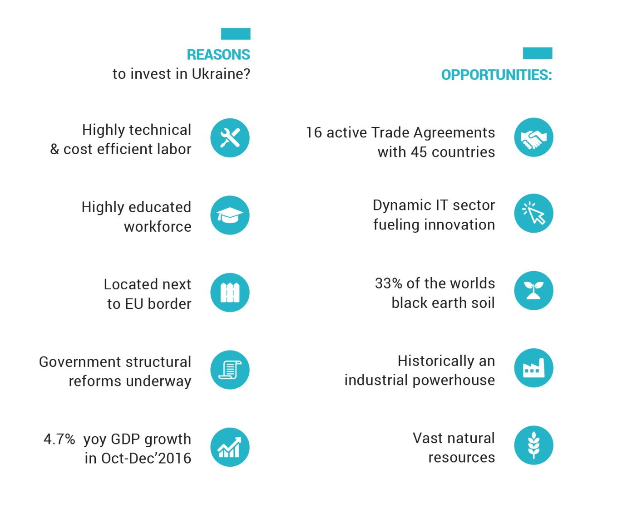
Why Invest in Ukraine?

Slide 11
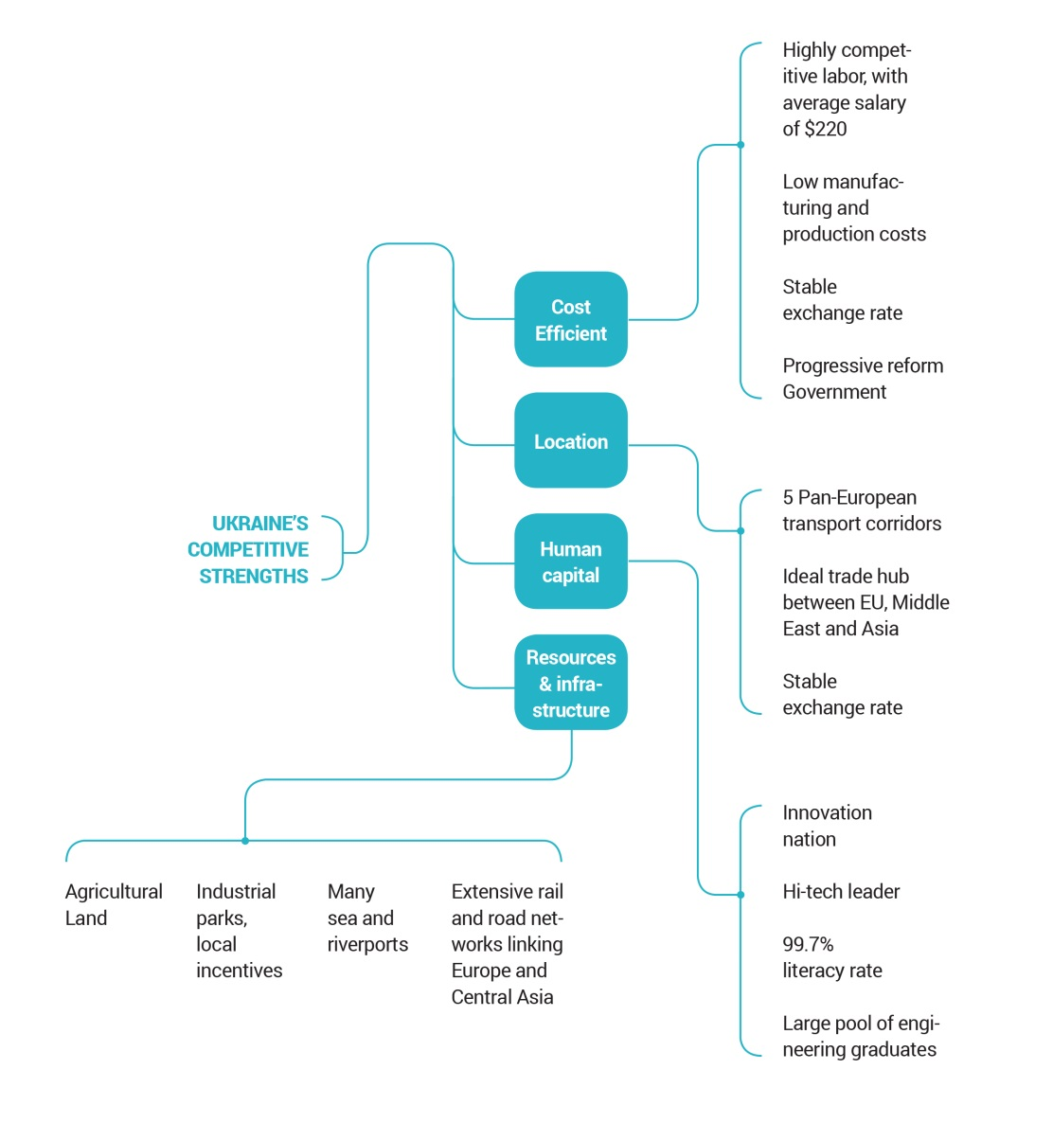
Why Invest in Ukraine?

Slide 12
UkraineInvest Services
Navigation and Guidance
Understanding investor needs
Identifying local locations and opportunities for consideration
Introductions
To business, government and service providers across Ukraine
Information and Insight
Providing facts, data, and the local perspective leading to true insight
Advocacy
Addressing and resolving investor questions or issues
Acting as a voice of business to the government

Slide 13
Coordinating with a Variety of Partners and Influencers
Market Professionals
Central Government
Business Associations
UkraineInvest
Business Ombudsman
Diplomatic Corps
Local Government

Slide 14
Dziękuję!
www.ukraineinvest.com
howcanwehelp@ukraineinvest.com
Cabinet of Ministers of Ukraine
12/2 Hrushevskoho St., Office 148
Kyiv, Ukraine, 01008

